Slide 1
District 1
Supervisor Rex Scott
-
Email: district1@pima.gov
-
520-724-2738

Slide 2
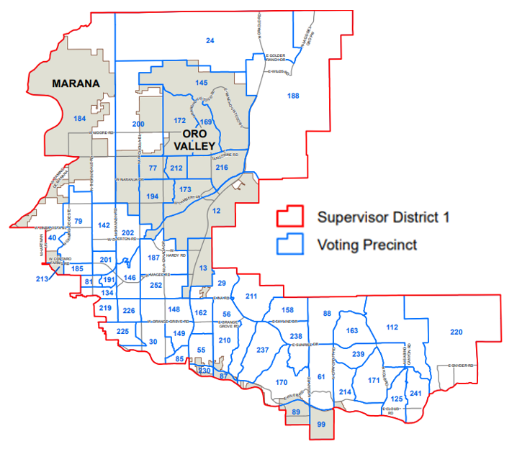
District Map
Supervisor Rex Scott
-
Email: district1@pima.gov
-
520-724-2738

Slide 3
Pima County District 1 Supervisor Rex Scott
Roles of Board of Supervisors
Subdivisions of the state
“Essential role of government”
Budget and Oversight
Constituent Services
Supervisor Rex Scott
-
Email: district1@pima.gov
-
520-724-2738

Slide 4
Addressing Constituent Requests
Working with Pima County departments:
Development Services/Planning & Zoning
Health Department
Natural Resources, Parks and Recreation
Transportation - “SeeClickFix”
Regional Flood Control District
Supervisor Rex Scott
-
Email: district1@pima.gov
-
520-724-2738

Slide 5
Areas of Concern and Focus
Economic Development
Prosperity Initiative
Roads and Transportation
Quality Early Childhood Education
Homelessness and Housing
FY23 and FY24 committed $9.4 million to build 1038 affordable units
County Supervisors Association
Tucson Water Ruling
Supervisor Rex Scott
-
Email: district1@pima.gov
-
520-724-2738

Slide 6
Planning Our Future
Comprehensive Plan Review – please comment https://www.pima.gov/270/Pima-Prospers
Regional Affordable Housing Commission
Economic Development Strategic Plan
Regional Transportation Authority – RTA Next
Supervisor Rex Scott
-
Email: district1@pima.gov
-
520-724-2738

Slide 7
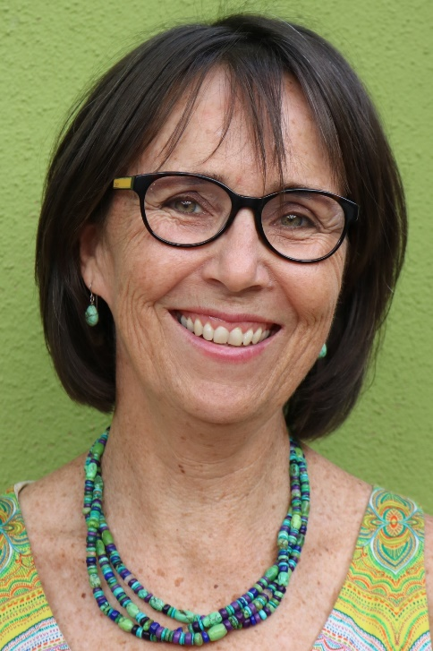
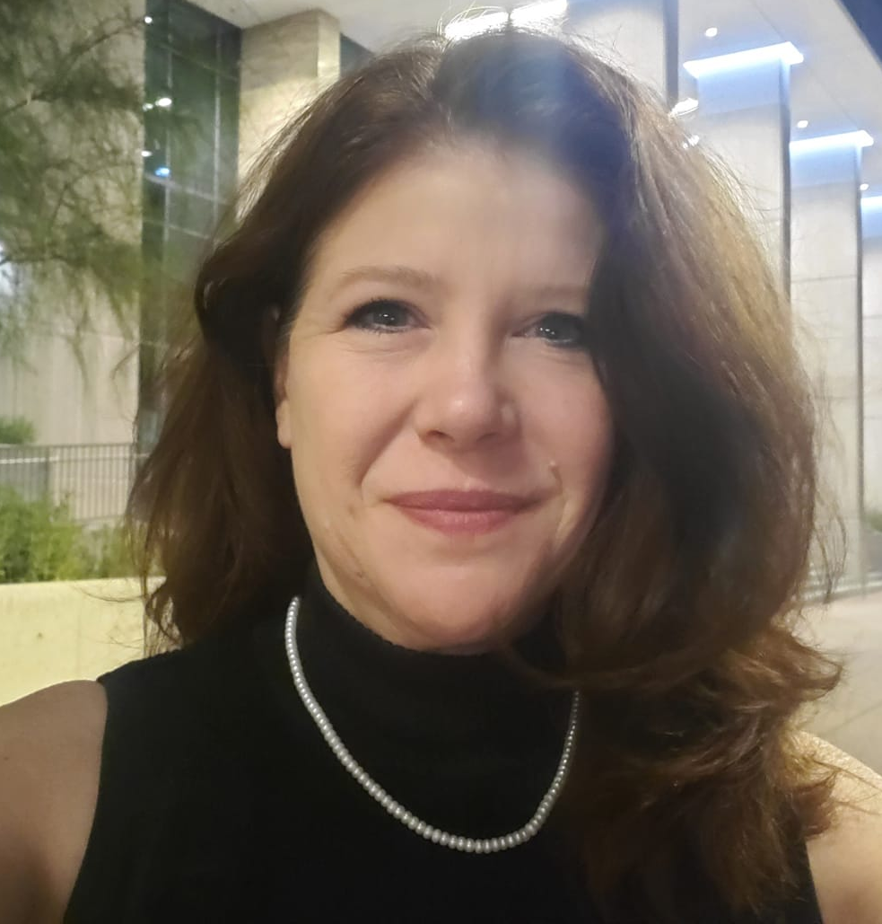
Pima County District 1 Staff
Cami Evans Kate Hiller Kim Briggs
Contact us at District1@pima.gov
Supervisor Rex Scott
-
Email: district1@pima.gov
-
520-724-2738

Slide 8
Contact District 1
Phone: 520-724-2738
Email: District1@pima.gov
Website: District1.pima.gov
@District1S
@RexScott.D1
Newsletter
Supervisor Rex Scott
-
Email: district1@pima.gov
-
520-724-2738

